Slide 1
EPAM .NET ACADEMY Demo2 by Jeffery

Slide 2
1.
About what I learned.
.Net Collections
Strings
List
Dictionary
File IO Operation
FILE class
Streamreader class
Streamwriter class
Error Handling
OOP Basics
Inheritance
Encapsulation
Polymorphism
Notes:
Error Handling you can find out what causes the error or you can define your own error handling function to optimize the behavior of the function
Encapsulation is about hiding imformations, programmer can focus on new object without worry about hidden details.
Polymorphism is the ability to redefine methods for derived class;

Slide 3

VARIABLE NAMING
There are some useful advices for “Code Monkeys” regarding to variable naming.

Slide 4

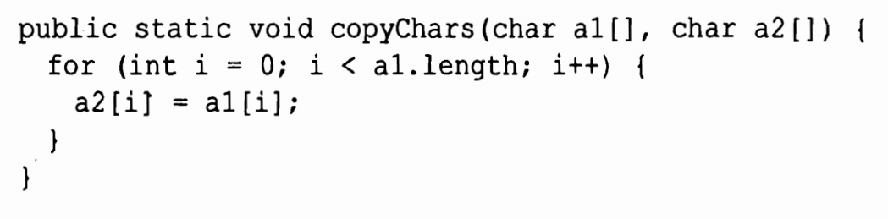
Why not use source and destination?

Slide 5
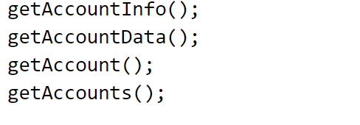
Use distinguishable names.

Slide 6
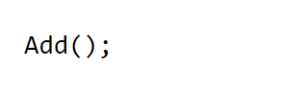
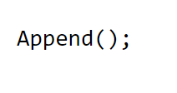
Add is about 1+1.
Append is about one person join a queue.

Slide 7
THANKS!

